Slide 1
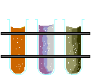
SCH 3u
ROCHELEAU

Slide 2

WHAT IS a scientist?
They ASK and ANSWER questions… Basically, it’s all about their attitude… Scientists themselves are … SKEPTICAL – They must be able to TEST PHENOMENA!!!
If it can’t be tested… It’s NOT SCIENCE!
Scientists WONDER, QUESTION, and strive to find out WHY, and experiment, - they have the same attitude as most small children and well…. Ms. Rocheleau
Scientists are adults who’ve never lost that wonder of nature and desire to know.

Slide 3

WHAT EXACTLY IS CHEMISTRY?
It’s all about matter, which is anything that occupies a space and has a mass.
Chemistry is the study of the composition and properties of matter and the changes it undergoes.

Slide 4


The Basic branches of the Chemis tree
Analytical Chemistry
Biochemistry
Inorganic Chemistry
Chemis TREE
Wow your teacher is so funny!!!
Physical Chemistry
Organic Chemistry
Biotechnology

Slide 5

ANALYTICAL CHEMISTRY
This branch is highly involved in the analysis of substances.
Chemists from this field may be trying to fin out what substances are in a mixture a.k.a. qualitative analysis or how much of a particular substance is present a.k.a. quantitative analysis.

Slide 6

BIOCHEMISTRY
This branch specializes in living organisms and systems.
Biochemists study the chemical reactions that occur at the molecular level of an organism .
Biochemists study processes such as digestion, metabolism, reproduction, respiration, and so on and so forth…
It can be hard to distinguish between a biochemist and a molecular biologist because they both study living systems at a microscopic level but biochemists concentrate more on the reactions that are occurring.

Slide 7
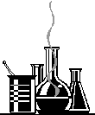
PHYSICAL CHEMISTRY
This branch figures out how and why a chemical system behaves as it does.
Physical chemists study the physical properties and behavior of matter and try to develop models and theories that describe this behavior.

Slide 8

Organic chemistry
This is the study of CARBON and its compounds.
It’s the most organized of the areas of chemistry – with good reason.
There are MILLIONS of organic compounds, with thousands more discovered or created each year.
Industries such as the polymer industry, the petrochemical industry, and the pharmaceutical industry depend on organic chemists.

Slide 9

Inorganic chemistry
This branch is involved in the study of inorganic compounds such as salts. A salt, in chemistry, is defined as the product formed from the neutralization reaction of acids and bases. Salts are ionic compounds composed of cations <meow >(positively charged ions) and anions (negative ions) so that the product is electrically neutral (without a net charge).
  A base and an acid, e.g. NH₃ + HCl → NH₄Cl
It includes the study of inorganic properties of these compounds.
It also includes the study of the individual elements of the inorganic compound. Basically they study everything that doesn’t involve carbon. They leave that to the organic chemists!!

Slide 10

Biotechnology
It’s the application of biochemistry and biology when creating or modifying genetic material or organisms for specific purposes.
It’s used in such areas as cloning and the creation of disease resistant crops, and it has the potential of eliminating genetic diseases in the future.

Slide 11

Pure vs APPLIEd CHEMISTRY
Pure chemists are free to carry out whatever research interest them – or whatever they can get funded. The researcher basically wants to know for the sake of knowledge, often called basic research. Chemists use undergraduate or graduate students to help conduct the research. The work becomes part of the professional training of the student. The researcher publishes his or her work in professional journals for other chemists to examine and attempt to refute. Funding is always a problem because equipment and chemicals are expensive…
Applied chemists work for private corporations. Their research is directed toward a very specific short-term goal set by the company – product improvement or the development of a disease-resistant strain of corn for example. Money is available for equipment and instrumentation with applied chemistry but there’s also pressure to meet the company’s gaols.

Slide 12

Pure Chem and Applied Chem in the Real World
Share the same basic differences as SCIENCE VS TECHNOLOGY.
In SCIENCE (Pure Chem) the goal is simply the basic acquisition of knowledge. There doesn’t need to be any apparent practical application. Science is simply knowledge for knowledge’s sake.
TECHNOLOGY (Applied Chem) is the application of science toward a very specific goal.
Pure Chemists generate date used by applied chemists. Both types of chemists have their own sets of strengths, problems and pressures.
Because of dwindling federal dollars, many universities are becoming much more involved in gaining patents, and they’re being paid for technology transfers into the private sector…

Slide 13

What does a chemist do all day???
Chemists analyze substances.
  They may try to find the active compound in a substance found in nature, or may analyze water to see how much lead is present.
Chemists create, or synthesize new substances.
  They may try to make a synthetic version of a substance found in nature or create an entirely new compound. Find a way to make insulin, create a new plastic, pill or paint. Find a new, more efficient process to use for the production of an established product.
Chemists create models and test the predictive properties of substances.
  They may measure the strength of a new polymer strand or determine the octane rating of a new gasoline.

Slide 14
Where do chemists actually work???
You may be thinking that chemist can be found deep in a musty lab working for some large chemical company, but chemists hold a variety of jobs in a variety of places!!

Slide 15
Quality control chemists
These chemists analyze raw materials,
intermediate products, and final products for purity to make sure that they fall within specifications. They may also offer technical support for the customer to analyze returned products. Many of these chemists often solve problems when they occur within the manufacturing process.

Slide 16
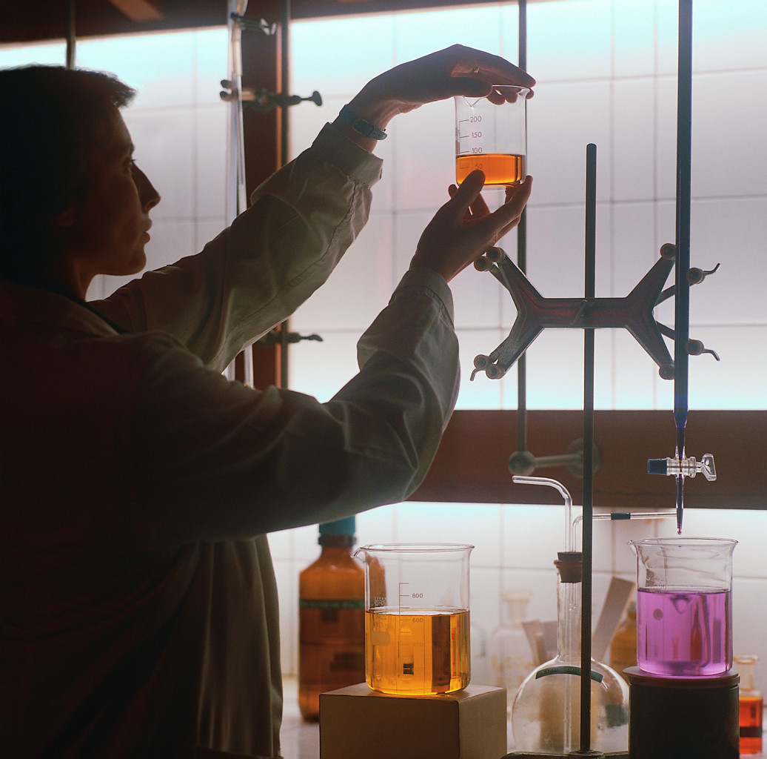
Industrial research chemists
Chemists in this profession perform a large number of physical and chemical tests on materials. They develop new products and they work on improving existing products. They work with particular customers to formulate products that meet specific needs. They also supply technical support to their customers.

Slide 17

Sales representatives
Chemists work as sales representatives for companies that sell chemicals or pharmaceuticals. They may call on their customers and let them know of new products being developed. They also help their customers solve problems.

Slide 18
Forensic chemist
Forensic chemists analyze sample taken from crime scenes or analyse samples for the presence of drugs or traces or elements and compounds. They are used to determine common uses and places where these elements and compounds are located. They are also called to testify in court as expert witnesses.

Slide 19
Environmental chemist
These chemists work for water purification plants, the Environmental Protection Agency, the Department of Energy, or similar agencies. This type of work appeals to people who like chemistry but also like to get out in nature. They often go to sites to collect their own sample.

Slide 20
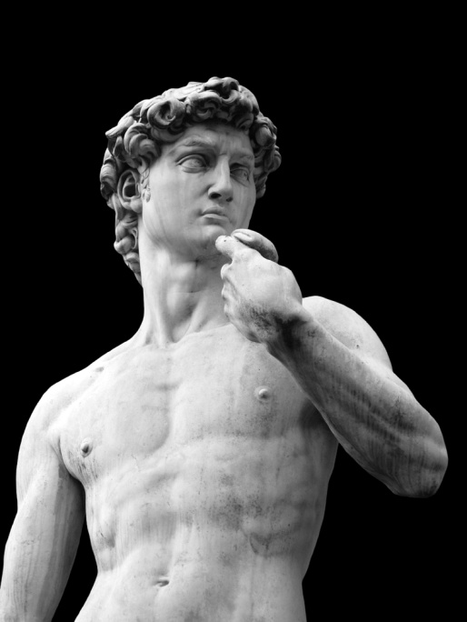
Preservationist of art and historical works
Chemists work to restore paintings and statues such as the Sistine Chapel ceiling and Mummies! They also preserve the precious artefacts and documents by ensuring the best environment by balancing the lighting, gases and temperatures within protective cases. They protect and preserve our heritage. They also detect forgeries.

Slide 21
Chemical educator
Chemists working as educators teach in public schools and colleges and universities. University professors conduct research and work with undergraduate and graduate students.

Slide 22
There are MANY many mnay more!!!!
These were just a few that I thought may interest you!!! I didn’t even touch on
  LAW
  MEDICINE
  TECHNICAL WRITING
  GOVERNMENTAL RELATIONS
  CONSULTING
We only have so much time to discuss this!!!

Slide 23
If you aren’t interested in becoming a chemist, why should you be interested in chemisty??
(Quick Answer) To pass this course….
Everything you touch, eat etc. has gone through the hands of a chemist!!! Think about it!! Pretty crazy when you think about it!
Chemist are involved in almost every aspect of society.
Since Chemistry is part of our everyday world, knowing something about chemistry will help you interact more effectively with our chemical environment.

Slide 24
You will need your Periodic Table for This one!!
Periodic Table Song
http://www.youtube.com/watch?v=GFIvXVMbII0
http://www.privatehand.com/flash/elements.html
http://www.edu-cyberpg.com/IEC/elementsong.html

Slide 25
Quick thinking!!!
If H₂O is water, what is H₂O₄?
It’s for drinking, bathing etc….

Slide 26
Quick thinking!!!
What weapon can you make from the Chemicals:
Potassium, Nickel and Iron?
KniFe

Slide 27
Quick thinking!!!
Tell the rodeo cowboy what to do with the calf.
Europium

Slide 28
Quick thinking!!!
What did the gambler do with his cards?
Palladium

Slide 29
Quick thinking!!!
What does a chemist aim to do when he becomes flabby?
Fermium

Slide 30
Quick thinking!!!
If the molecule H₃NCONH₃ is Urea, what would you call the following molecule? H₃NCONH₃ -H₃NCONH₃
Diurea

Slide 31
Quick thinking!!!
Why do chemists like nitrates so much?
They’re cheaper than day rates.

Slide 32
Quick thinking!!!
What do you call a swim team made up of girls named Jennifer?
Hydrogens

Slide 33
Quick thinking!!!
What did one man say to another man while sitting on a porch in Kinmount?
That carbon there for days!

Slide 34
Quick thinking!!!
What are the doctor’s favourite elements?
Helium and Curium

Slide 35
Quick thinking!!!
What is a robber’s least favourite element?
Copper

Slide 36
Quick thinking!!!
What is a soccer mom’s favourite element?
Vanadium

Slide 37
Quick thinking!!!
What is Mickey Mouse’s favourite element?
Plutonium

Slide 38
Quick thinking!!!
What is Dr. Watson’s favourite element?
Holmium

Slide 39
Quick thinking!!!
What is a tailor’s favourite element?
Sodium

Slide 40
Quick thinking!!!
What is an orthopaedic surgeon’s favourite element?
Neon

Slide 41
Quick thinking!!!
What is a used car dealers favourite element?
Selenium

Slide 42
Quick thinking!!!
Which element is least likely to be at a party?
Boron

